Slide 1


High Speed Control System with PCIeXpress & FPGA
Sandeep Shah
Optimized Solutions Pvt Ltd

Slide 2





Optimized Solutions
ISO 9001:2008 certified Test, Measurement & Automation Solutions Provider
Team of Electronics, Instrumentation & Electrical Engineers
Technology Partnership

Slide 3
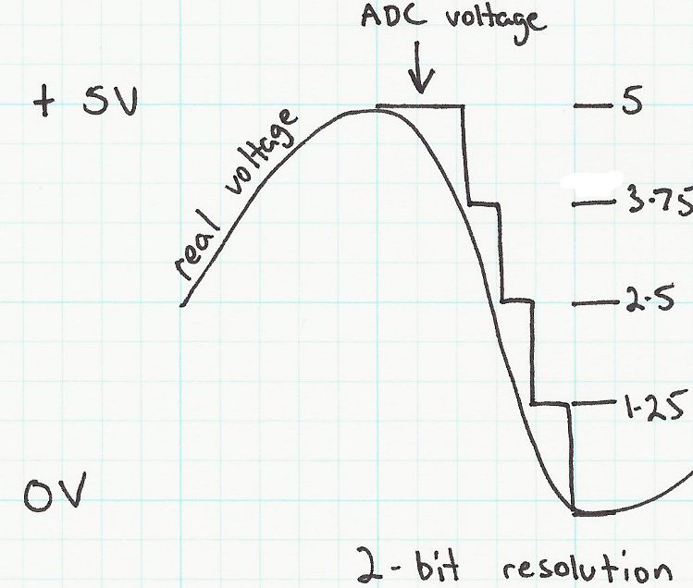
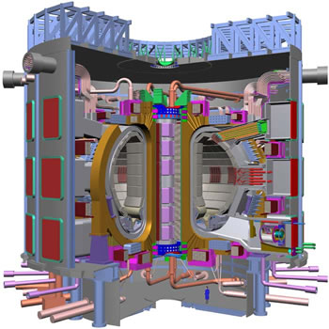

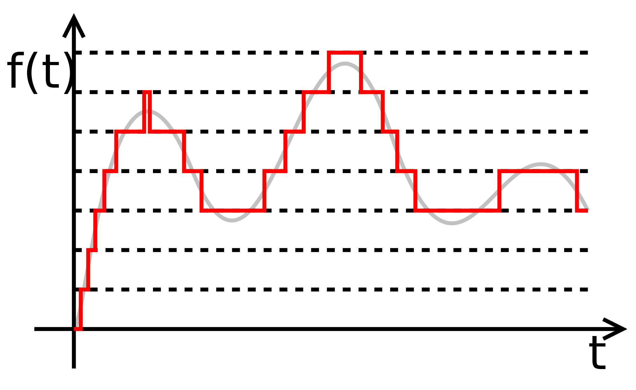
Control System limits
Sampling Time
Area of Improvement
P
R
O
C
E
S
S
O
R
Processing Time
PV Quantize
Update Time
Plant/ Machine
CV Output

Slide 4
Control System Platforms
Discrete Control Systems
Microcontrollers
Programmable Logic Controllers
Programmable Automation Controllers
Distributed Control Systems
FPGA

Slide 5
IndustrialBuses
Modbus
Profibus
Profinet
EtherCAT
Ethernet
Foundation Fieldbus
CAMAC
DeviceNet
CANopen
µTCA
VME
PCI
USB
PCI Express

Slide 6







Data Buses
Fast Ethernet
PCI
GPIB
Gigabit Ethernet
VMEbus

Slide 7
Performance

Slide 8
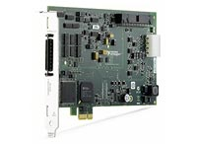
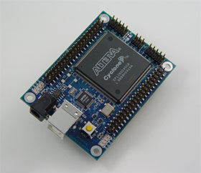
PCI Express & FPGA
PCI Express
Bandwidth x16 Gen3: 24 GB/s
FPGA
Programmable Logic in Hardware
Flexibility of Field/Site Changes
Speed of Hardware

Slide 9
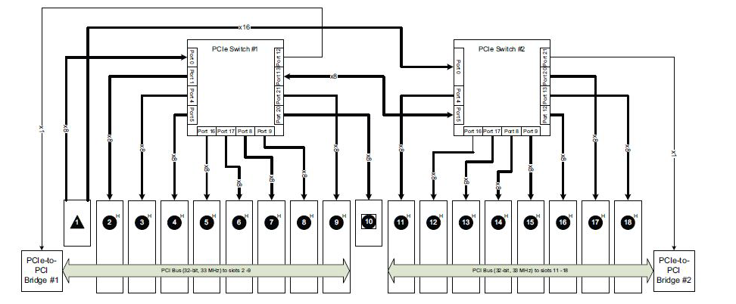
PXI Express, FlexRIO & PLC
PXI Express Switch
4 GB/s Sustained Data Rate for each slot

Slide 10
PXI
100 MHz
Differential CLK
PXI Express
Star
Trigger
SYNC100
10 MHz
CLK
PXI Express
System
Timing Slot
PXI Express
Hybrid
Peripheral
PXI Express
Hybrid
Peripheral
PXI Express
Hybrid
Peripheral
PXI
Peripheral
SYNC Control
Differential Star
Triggers
PXI Trigger Bus (8 TTL Triggers)

Slide 11
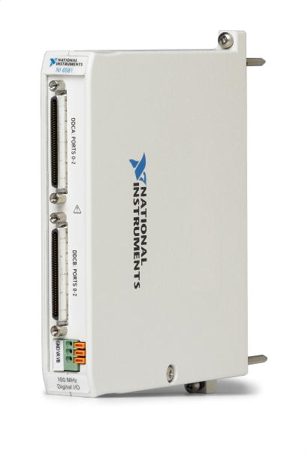
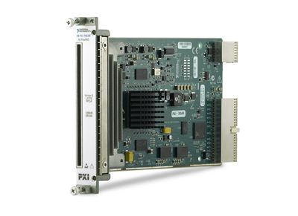
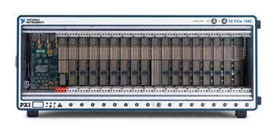
PCI Express & FlexRIO
FLEXRIO
Upto 2 GS/s sampling speed
Upto 32 channels @ 50 MS/s
Upto 16 – bit resolution
Xilinx Virtex – 5 LX 110 FPGA
Back end of PXI Express @ 24 GB/s

Slide 12
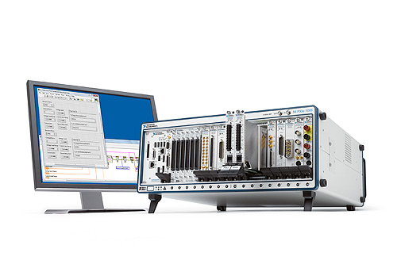
PXI Express & FlexRIO

Slide 13
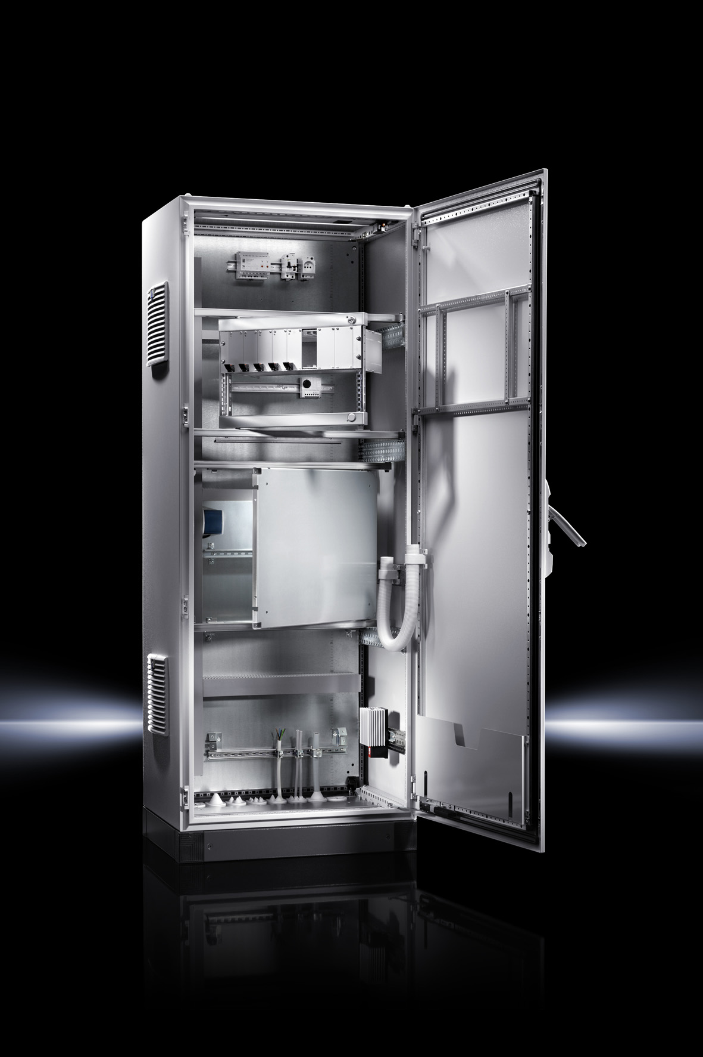
Application Case study
Power Supply Control
Components
PXI Express System with RTOS
FPGA Module
PLC
HMI
LabVIEW based Host Computer
Interfacing with Keithley Data Logger

Slide 14
Application Case study
Power Supply Control
Benefits
Acquisition @ 1µs
Process loop rate @ 25kHz
Interlock output within 5µs
Sequential States implemented at low cost and in STL
Interfaced third party devices over TCP/IP Ethernet
Local HMI for Experiment preparation

Slide 15












CLIENTELE
Aerospace
Defense
Physics Research
Process Plants
Education

Slide 16
CLIENTELE IN PHYSICS
Institute for Plasma Resarch
Raja Ramanna Center for Advanced Techniques
ITER India
BARC Mumbai
Tata Institute of Fundamental Research
Physical Research Laboratory
National Physical Laboratory

Slide 17

THANK YOU
SANDEEP SHAH
sandeep@ospl.in
+91 98 7959 8085
Optimized Solutions Pvt Ltd
Ahmedabad, INDIA
/optimizedsolutions
www.optimized.solutions

